Slide 1
Module 2

Slide 2
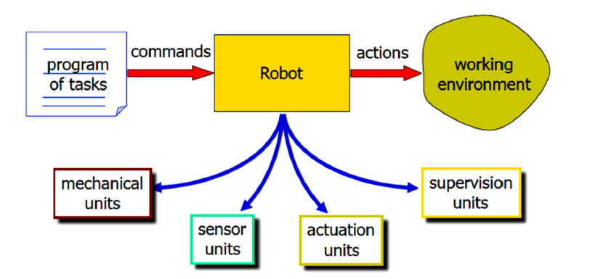
Introduction

Slide 3
Sensors
A sensor is a device that converts a physical parameter or an environmental characteristic (e.g., temperature, distance, speed, etc.) into a signal that can be digitally measured and processed to perform specific tasks.
Mobile robots need sensors to measure properties of their environment, thus allowing for safe navigation, complex perception and corresponding actions and effective interactions with other agents that populate it.

Slide 4
Sensors
Sensors used by mobile robots range from simple tactile sensors, such as bumpers, to complex vision-based sensors such as structured light cameras.
All of them provide a digital output (e.g., a string, a set of values, a matrix, etc.) that can be processed by the robot’s computer.
Output is obtained by discretizing one or more analog electrical signals by using an Analog to Digital Converter (ADC) included in the sensor.

Slide 5
Sensors Classifications
Sensor can be classified in several ways
based on the source of the excitation signal
the measurement domain
measurement type

Slide 6
Excitation Signal Source (Passive and Active Sensors)
A sensor is generally classified as passive if it does not require, except for the signal amplification and digital conversion, a power supply to operate.
A passive sensor changes its output in response to an excitation signal generated by an external phenomena, e.g., a microphone that senses a human voice.

Slide 7
An active sensor requires an external power supply to self generate the excitation signal, and it measures the environmental reaction to such a signal, e.g. a sonar that emits a sound pulse and then senses the reflected wave of the pulse.
An alternative definition used in mobile robotics indicates passive sensors as sensors that include only receiver transducers, and active sensors as sensors that also include one or more emitter transducers

Slide 8
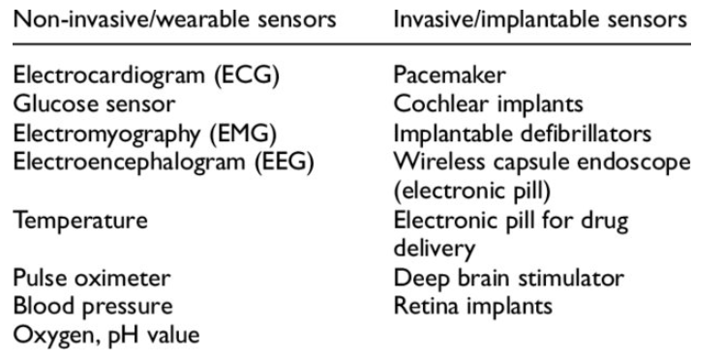

Slide 9
Measurement Domain (Proprioceptive and Exteroceptive Sensors)
A sensor is classified as proprioceptive if it measures a quantity that depends only on the internal robot system and its current internal state (e.g. wheels position, rotational speed,etc.).
On the other side, an exteroceptive sensor measures a quantity that depends on both the robot state (e.g., its position) and the environment surrounding the robot, for example the distance to the closest obstacle.

Slide 10
Measurement Type
A sensor can be classified on the basis of the type of measurement performed (e.g, robot speed, global position)

Slide 11
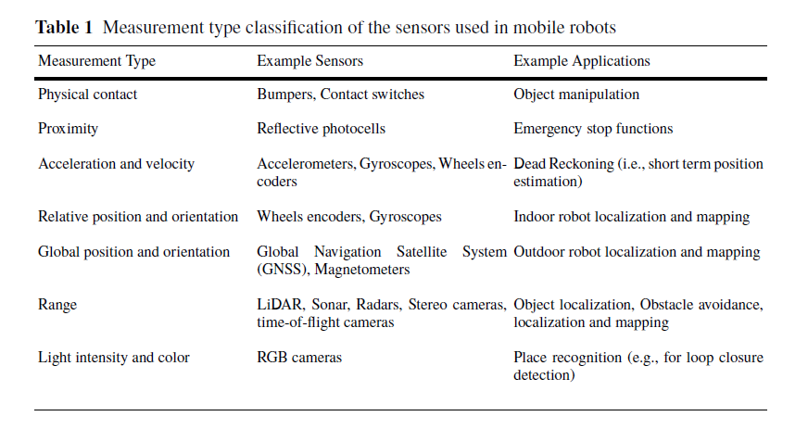

Slide 12
Sensors
Internal state sensor:
Internal sensors are used to measure the internal state of a robot.
These sensors deal with the detection of variable such as arm joint position, which are used in robot control.
It measures position, velocity, acceleration etc.
External state sensors:
These types of sensors are used to find the robot environment.
These sensors deal with the detection of variables such as range, proximity and touch.
External sensing is used for robot guidance, as well as for object identification and handling. External state sensors may be further classified as:
Contact sensors: These sensors respond to physical contact, such as touch, slip, and torque.
Non-contact sensors: These sensors rely on the response of a detector to variations in acoustic or electromagnetic radiation. The most prominent examples of noncontact sensors measure range, proximity, and visual properties of an object.

Slide 13
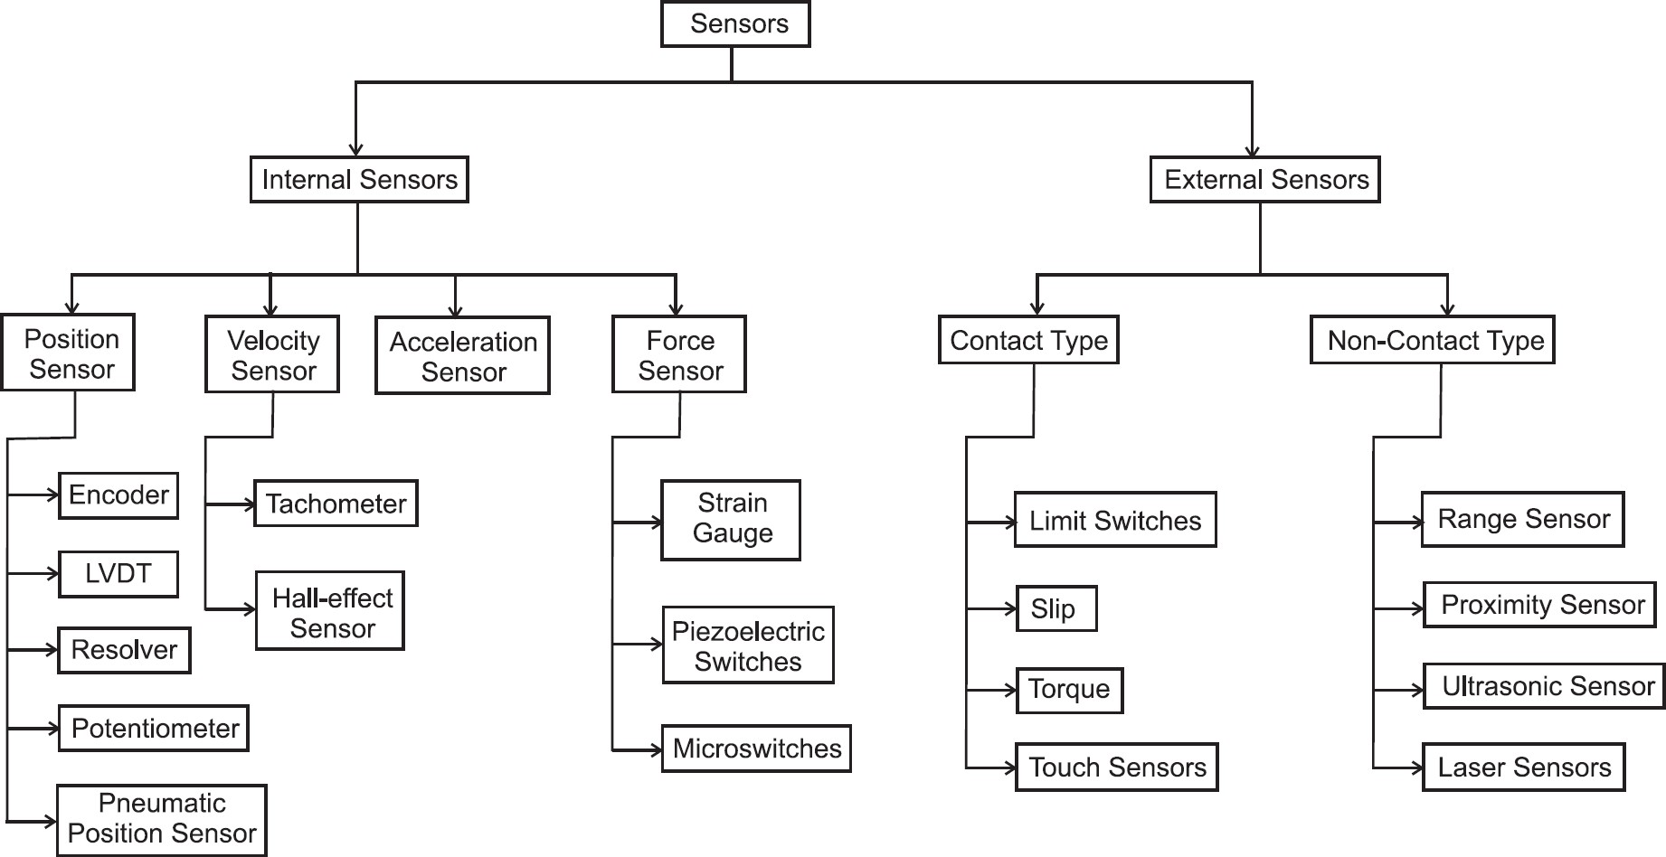

Slide 14
Position Sensors
Used to measure displacements, both angular and linear as well as movements
The position information may be used to calculate velocities
Common position sensors include
Potentiometer
Encoder
Linear Variacle Differential Transformer (LVDT)
Resolver

Slide 15
Potentiometer
Used to measure motion
Converts the position information into a variable voltage through a resistor
As the sliding contact (wiper) slides on the resistor due to a change in position, the proportion of the resistance before or after the point of contact with the wiper compared to the total resistance varies.
Need external power source

Slide 16
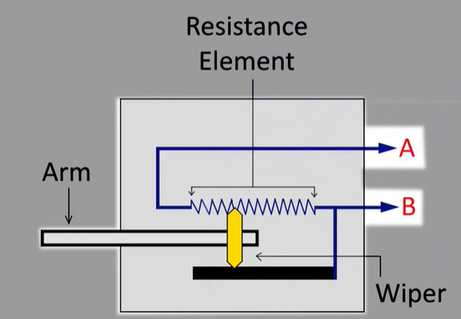

Slide 17
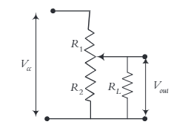
Potentiometer
Acts as a voltage divider
Potentiometers can be rotary or linear and thus can measure linear or rotary motions.
Rotary potentiometers can also be multiple-turn, enabling the user to measure many revolutions of motion.
Potentiometers are either wire wound or thin film deposit (also called conductive plastic), which is a deposit of a thin film of resistive material on a surface.

Slide 18


Notes:
https://www.youtube.com/watch?v=w5guhKAkqZw

Slide 19
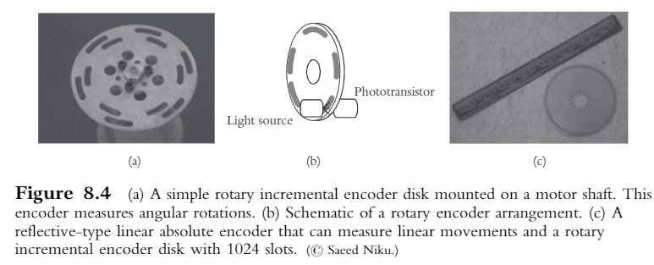
Encoders
A simple device that can output a digital signal for each small portion of a movement.
Encoder disk is divided into small sections

Slide 20
Each section is either opaque or transparent ( also it can be reflective or non-reflective
A light source such as LED on one side provides a beam of light to the other side of the encoder disk or strip
If the disk’s angular position is such that the light is revealed, the sensor on the opposite side will be turned on and will have a high signal.

Slide 21
If the angular position of the disk is such that the light is occluded, the sensor will be off and its value will be low.
As the disk rotates, it can continuously send signals.
If the signals are counted, the approximate total displacement of the disk can be measured at any time.

Slide 22
Encoders
Incremental
Absolute
Incremental
Areas of opaque and transparent sections are all equal and repeating.
Each represents an equal angle of rotation.
If the disk is divided into only two portions, each portion is 180 degrees
Its resolution will also be 180 degrees

Slide 23
If the number of division increases, the accuracy also increases

Slide 24
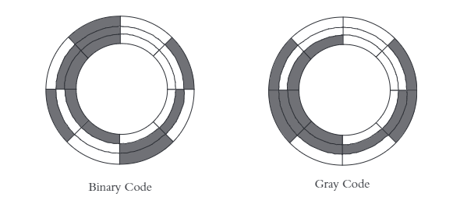
Absolute encoder
Each portion of the encoder disk’s angular displacement has a unique combination of clear / opaque sections that give it a unique signature.
This signature is used to determine the angular position of encoder
https://www.youtube.com/watch?v=nnk0DV5kgMk

Slide 25
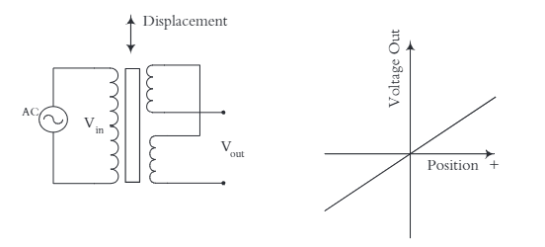
LVDT
A transformer whose core moves with the distance measured
Outputs a variable analog voltage as a result of this displacement

Slide 26
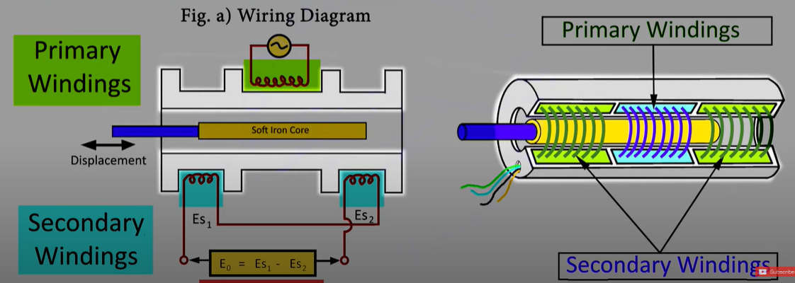
Transformer is an electric-to-electric energy converter that changes the voltage/current ratio.

Slide 27
The electrical energy into one coil creates a flux, which induces a voltage in the second coil proportional to the ratio of the number of turns in the windings.
The larger the number of turns in the secondary coil, the larger the voltage is, and, consequently, smaller the current is.
However, the induction of voltage in the secondary is very much a function of the strength of the flux.
If no iron core is present, the flux lines can disperse, reducing the strength of the magnetic field.
As a result, the induction of voltage in the secondary will be minimal.

Slide 28
In the presence of an iron core, the flux lines are gathered inward, increasing the strength of the field and thus the induced voltage.
This is used to create the output variable voltage in the linear variable differential transformer (LVDT).
The output of an LVDT is very linear, proportional to the input position of the core.

Slide 29
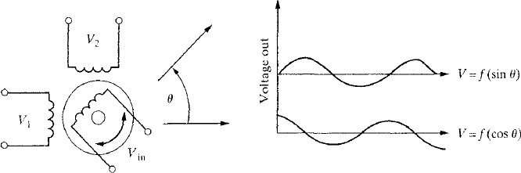
Resolvers
Resolvers are very similar to LVDTs in principle, but are used to measure an angular motion instead of linear motion.
A resolver is also a transformer, where the primary coil is connected to the rotating shaft and carries an alternating current through slip rings

Slide 30
There are two secondary coils, placed 90° apart from each other.
As the rotor rotates, the flux it develops rotates with it.
When the primary coil in the rotor is parallel to either of the two secondary coils, the voltage induced in that coil is maximum, while the other secondary coil that is perpendicular to it does not develop any voltage.
As the rotor rotates, eventually the voltage in the first secondary coil goes to zero, while the second coil develops its maximum voltage.
For all other angles in between, the two secondary coils develop a voltage proportional to the sine and cosine of the angle between the primary and the two secondary coils.

